Slide 1
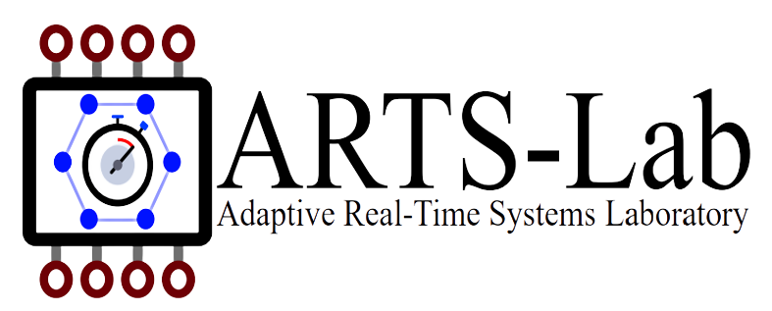
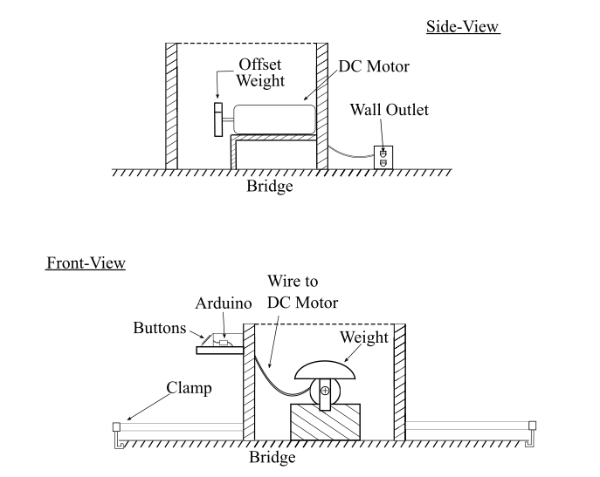
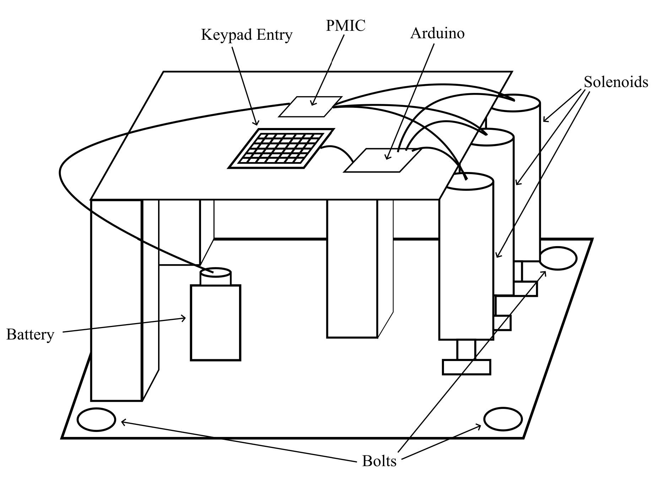
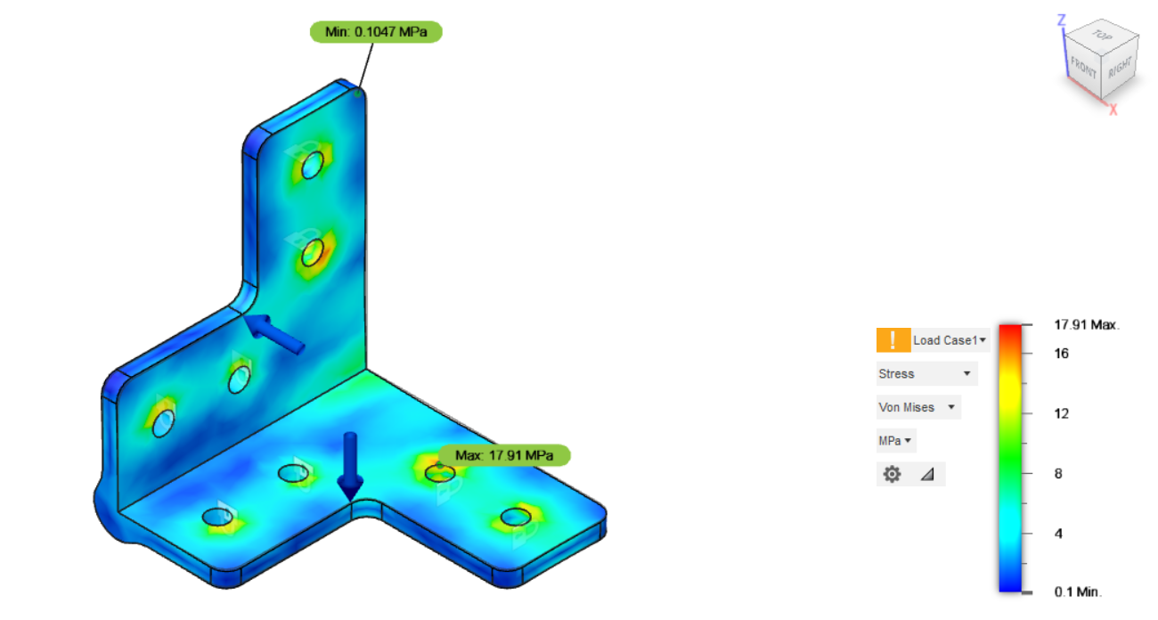
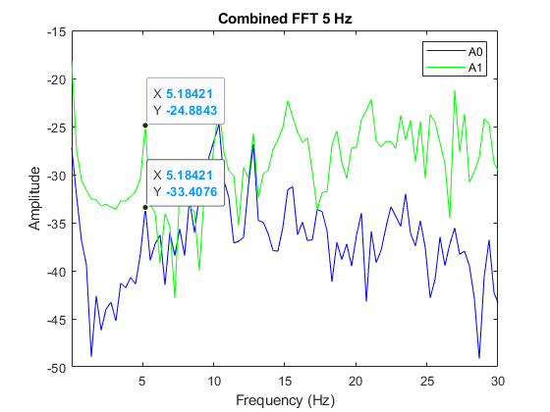
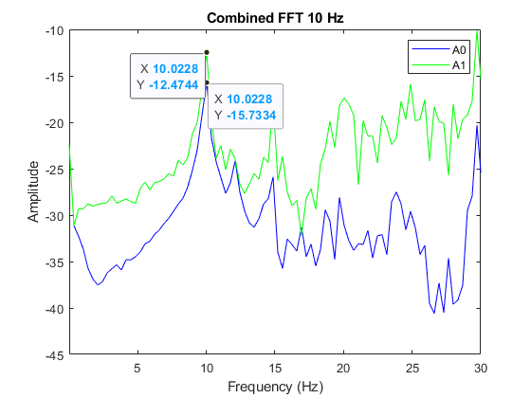
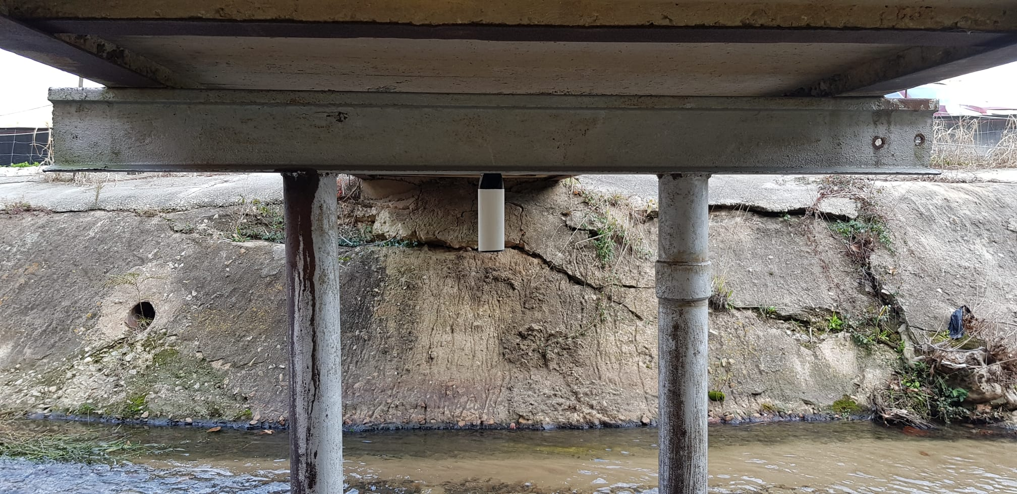
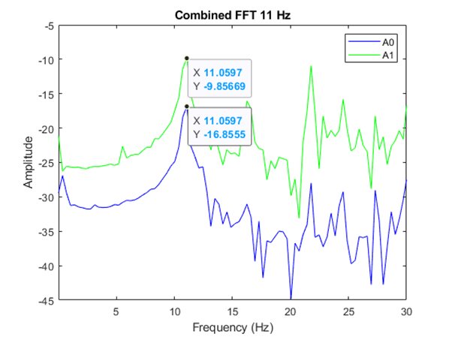
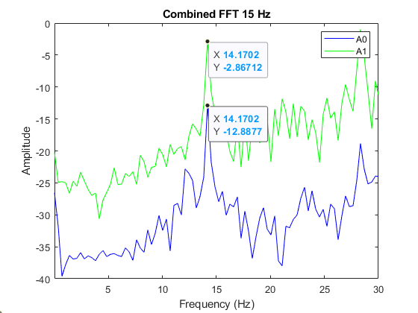
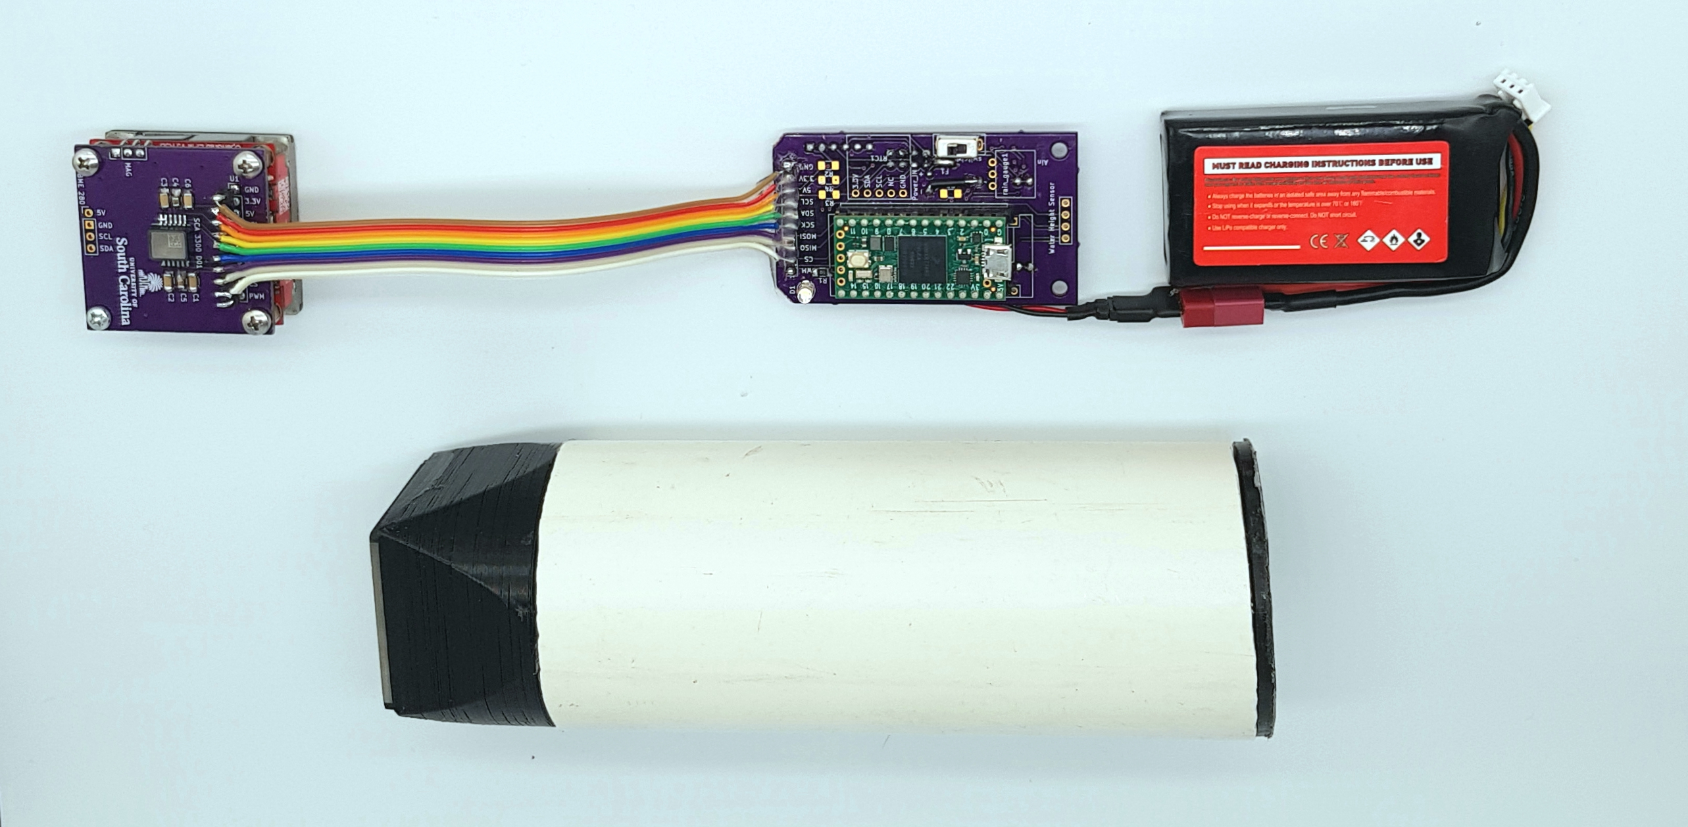
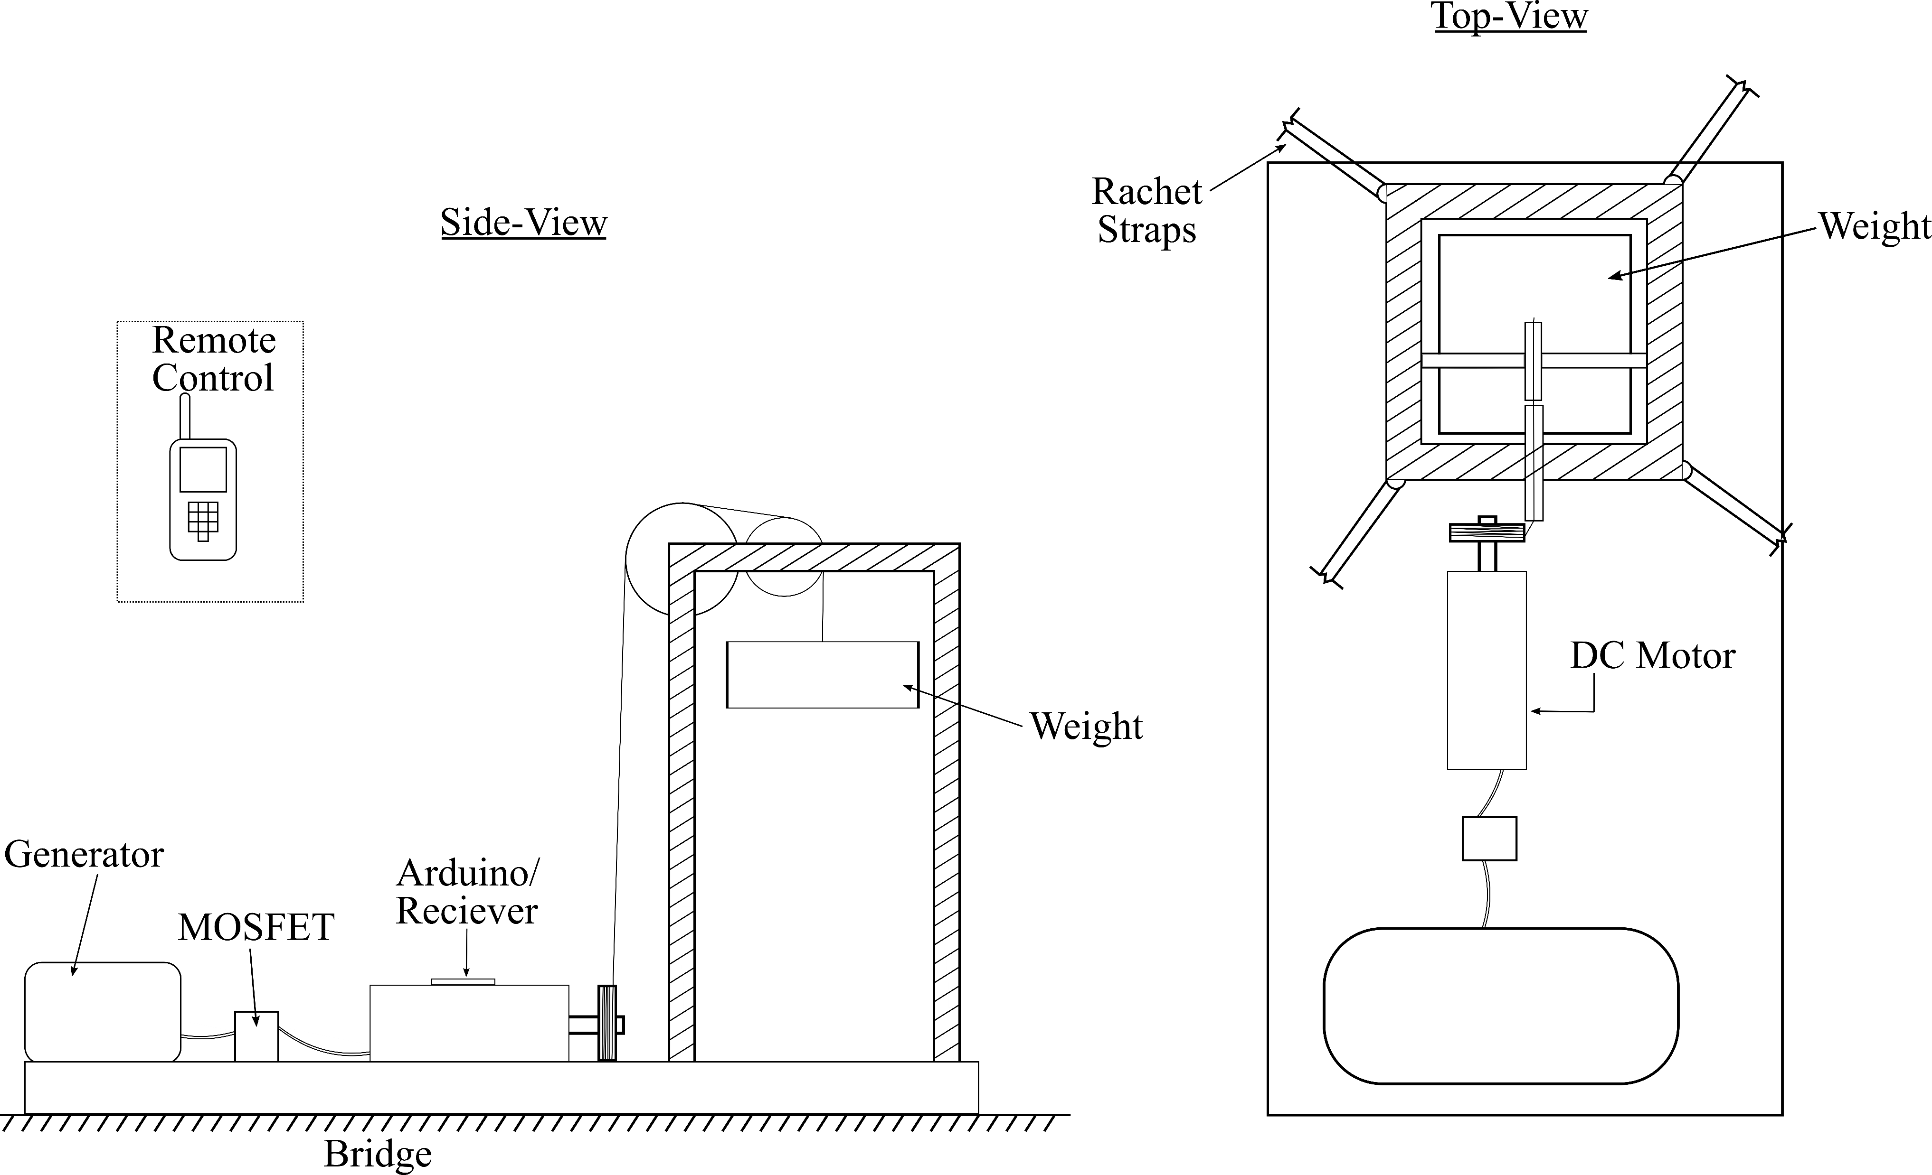
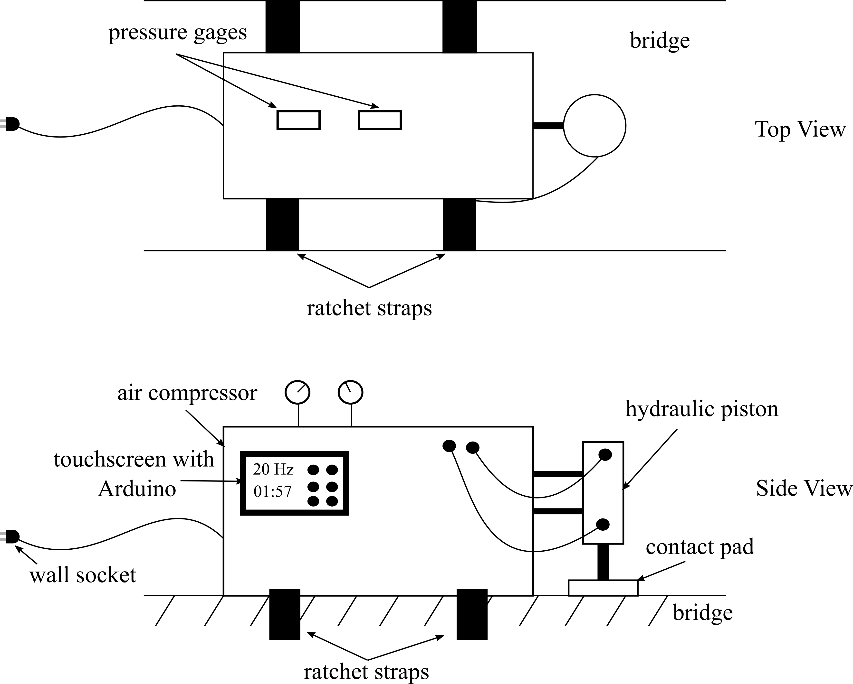
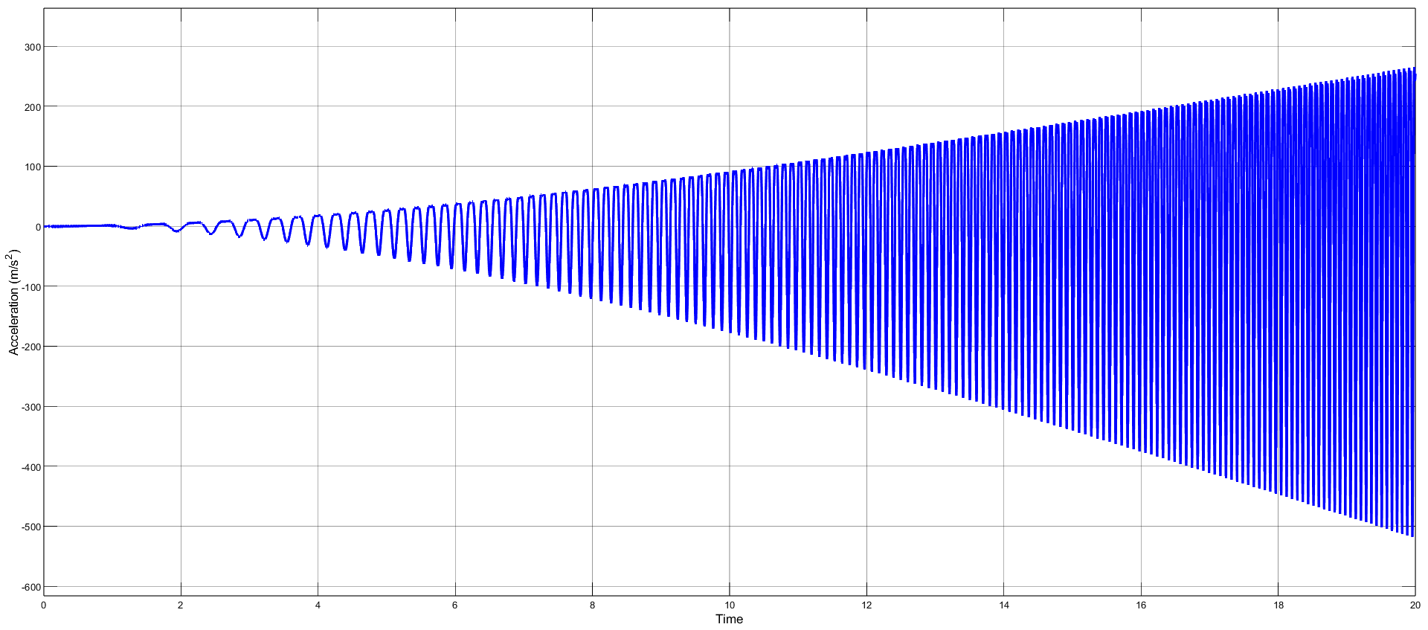
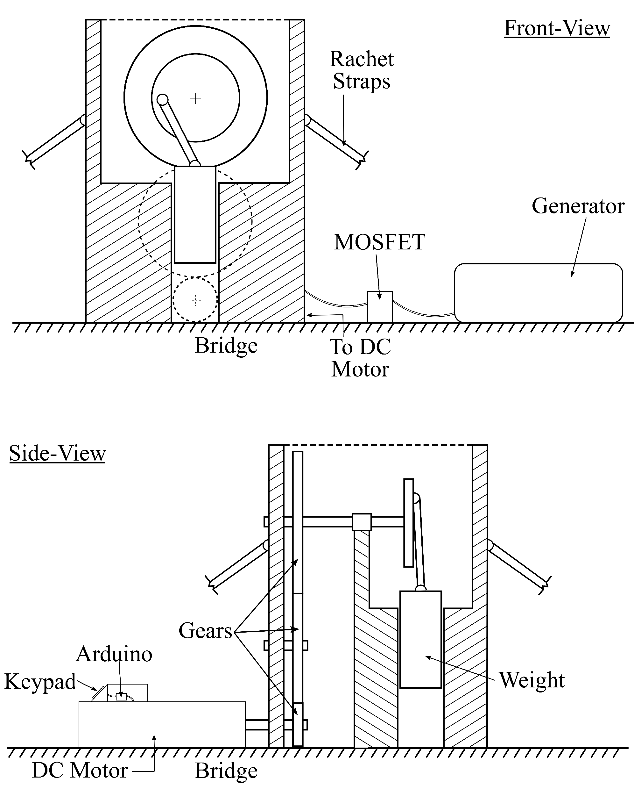
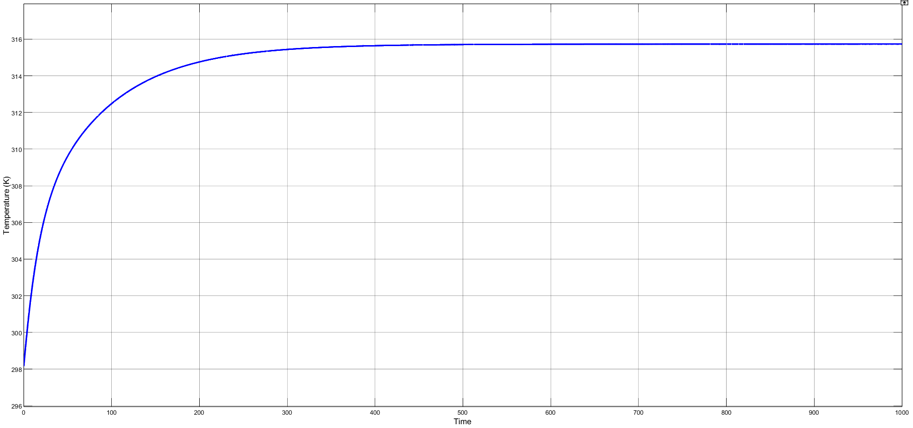
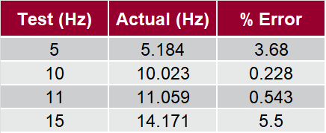
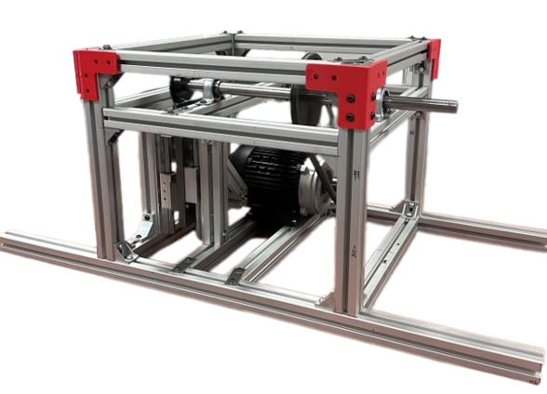
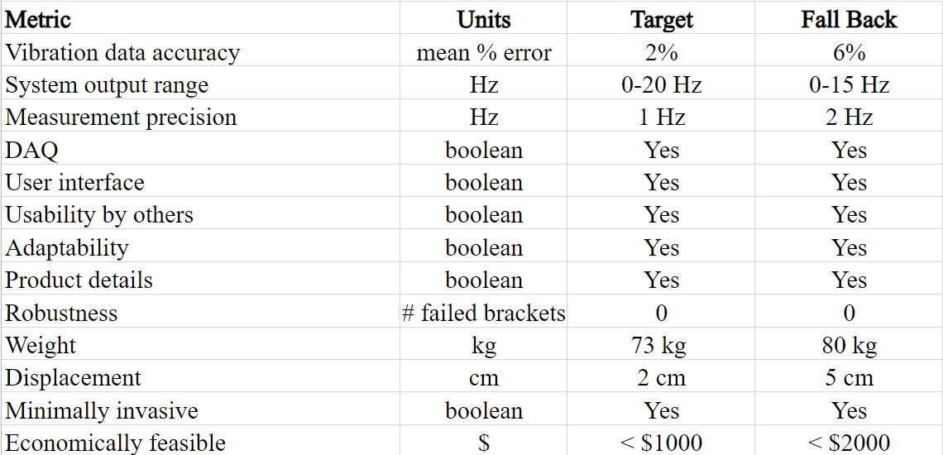
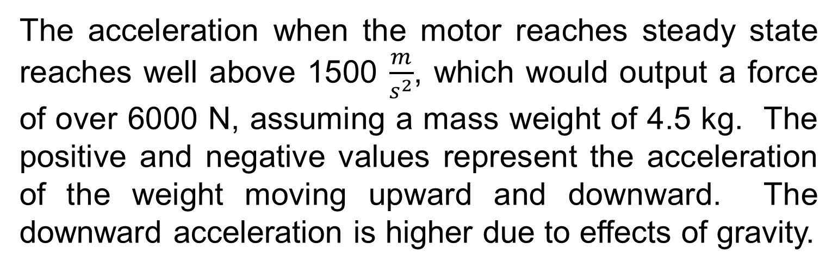
Mass Shaker
Corinne Smith, Ryan Brown, Alexander Toth, Ryan Yount
Dr. Austin Downey
Background
Concept Selection
Engineering Analysis
Results
The Adaptive Real-Time Systems (ARTS) Laboratory under Dr. Austin R.J. Downey is developing a sensor package to measure vibrations in bridges. A shaker is needed to excite the bridge to determine mode shapes. To do this, the team was tasked with creating a continuous vibration inducing mechanism to facilitate testing bridge dynamics.
Offset Weight Design
Solenoid Impact Design
Bracket stress simulation
An analysis was completed on the 3D printed brackets that were initially used in the construction of the shaker. A stress of 17.91 MPa was found to be the highest stress when undergoing 3000 N of force.
The above four graphs are Fast Fourier Transform (FFT) derived from a series of 10 second tests. A0 is the accelerometer on the bridge, A1 is the accelerometer on the shaker itself. The shaker can operate at different frequencies as shown by the changing nodes in both the green and blue lines across 5, 10, 11, and 15 Hz. A resolution of 1 Hz was reached and is displayed between the 10-11 Hz tests.
The shaker is very portable weighing only 50 kg. the robustness was tested in the form of broken brackets during operation. More than one bracket broke when the group excited a frequency at the upper limit of the shakers capability which lessened the contact to the bridge. This issue has been addressed and fixed.
Sensor package in development
Drop Weight Design
Hydraulic Piston Design
Acceleration (m/s²)
Needs and Specifications
The team conversed with Dr. Austin Downey as well as doctoral candidate Joud Satme to produce a list of needs that were seen as suitable for this project. 36 needs were identified and then the most important needs were determined through two rounds of voting. The resulting project needs are listed in the table below.
Time
Acceleration/Force Simulation
The acceleration when the motor reaches steady state reaches well above 1500 $\frac{m}{s^{2}}$, which would output a force of over 6000 N, assuming a mass weight of 4.5 kg. The positive and negative values represent the acceleration of the weight moving upward and downward. The downward acceleration is higher due to effects of gravity.
Linear Vibration Translation Design
Conclusion/Recommendations
Mission Statement
The above five concepts were developed through a concept creation process. The shaker needs to induce vibrations in the bridge, so the structure must be strong enough to withstand the force of operation, be simple and robust enough to operate, while still being capable of putting high levels of vibration down into the bridge. For these reasons, the ‘Linear Vibration Translation Design’ was chosen to move forward. The final product of the shaker is shown below.
Temperature (K)
“Dr. Austin Downey needs a bridge shaker that needs to test vibration data, operate at different frequencies, be safe to operate, and leave the bridge undamaged.”
Time
The table above shows the percent error of the shaker excitation (what the group set it to), and the actual value outputted (the frequency recorded). Low percent errors were found for all the frequencies.
To create a sounder structure, the team recommends a more permanent form of assembly such as welding or more advanced bracketing. Additionally, the team is in the process of adding additional safety measures to ensure the safety of the operators, the shaker, and the structure being examined.
Temperature of motor over time
Product Specification
The motor is subjected to 105.372 K or 90 ℉ heat through operation. The temperature of the motor rises and levels off at steady state without reaching extreme temperatures, as the maximum temperature reached is less than 316 K, or 109.13 ℉ . This is well within safe operating temperatures for AC motors.
The most vital aspects of the shaker were determined. Parameters for target and fallback specifications were set in place for the team to try to create.
Testing
The team began testing the shaker to ensure that all the key needs were met. Tests were conducted to ensure that the shaker could test vibration data, operate at different frequencies and have a resolution of 1 Hz. Three more tests were conducted on the structure of the shaker. These tests were for portability, robustness, and contact/energy transfer to bridge.
Acknowledgements
Project Sponsor: Dr. Austin Downey
Stakeholder: Joud Satme
Instructor: Dr. Andrew Sabalowsky
Machine Shop Expert: Bill Bradley
Final Design Product
Notes:
Current manual methods for determining the desired geometric parameters are time consuming. In order for this process to be applied in a clinical setting, Euclid aims to build a platform for automatically characterizing geometric attributes from a patient’s carotid artery CT scan and return the OSI, SS, and RRT.

